Slide 1
Be Prepared - #1 mistake no plan, no docs

Slide 2
USE CHECKLISTS

Slide 3
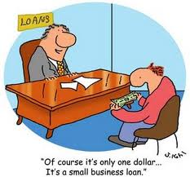
“How Much can I get ????”
Be Prepared – Know How Much You Need

Slide 4
Sustainable growth rate
The Tortoise or The Hare

Slide 5
FINANCIAL GAP

Slide 6
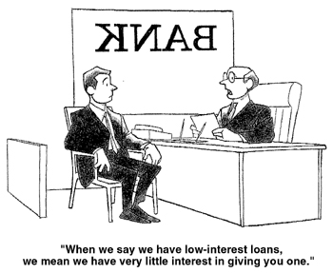
OTHER TIPS

